Slide 1
The Head
Chapter 23

Slide 2
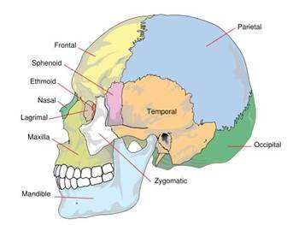
The Head
The cranium is a collection of bones fused together to protect the brain
The frontal brain makes up the forehead
The temporal bone forms the sides and base
Located in the temporal bone, behind the ears are the mastoid sinuses, located within the mastoid process
The occipital bone is the most posterior bone
The spinal cord passes through the occipital bone through the large opening called the foramen magnum
Largest bones of the cranium are the parietal bones
Protects a large portion of the brain
All of the cranial bones are joined at immovable joints called sutures

Slide 3
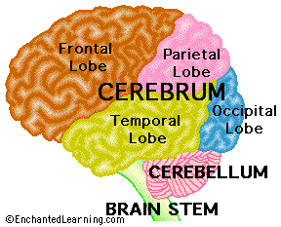
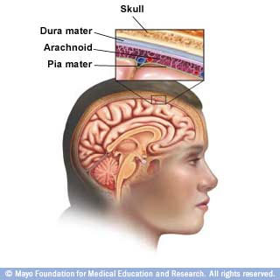
The Brain
Subdivided into portions
Brain stem
The most basic part of the human brain and controls many of the life-sustaining functions of the body
Ex. Breathing and heartbeat
Cerebellum
Controls muscular coordination
Cerebrum
The center for all complex brain activities and sensory reception
Divided into left and right hemispheres
Meninges
The membranes that surround the brain and spinal cord
Pia Mater,
Arachnoid
Dura mater

Slide 4
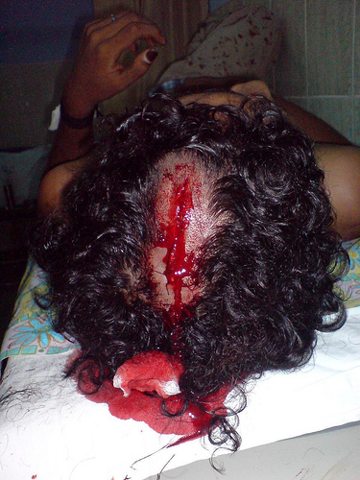
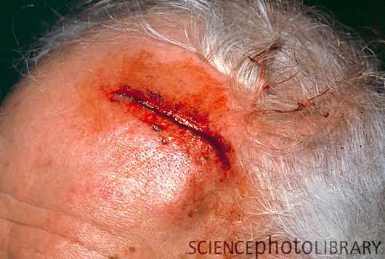
Head Injuries – Scalp Injuries
Injuries may or may not involve the skull or brain
Common athletic injuries are scalp contusions and lacerations
Symptoms
Local tenderness
Swelling
Bleeding
Treatment
Locating source of bleeding
Controlling it by direct pressure
Care should be taken not to depress the fracture site with added pressure

Slide 5
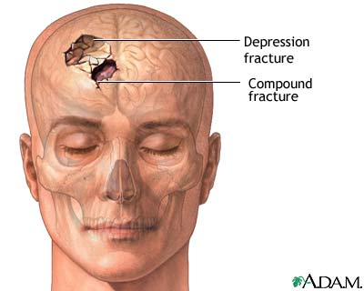
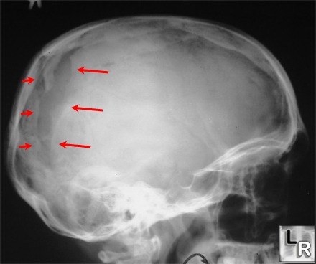
Head Injuries – Skull Fractures
Range from a simple linear fracture to a severe compound depression fracture, with bone fragments lacerating brain tissue
Symptoms
Bleeding
Cerebrospinal fluid drainage from the ear to nose
Treatment
Activating EMS
Treating shock

Slide 6
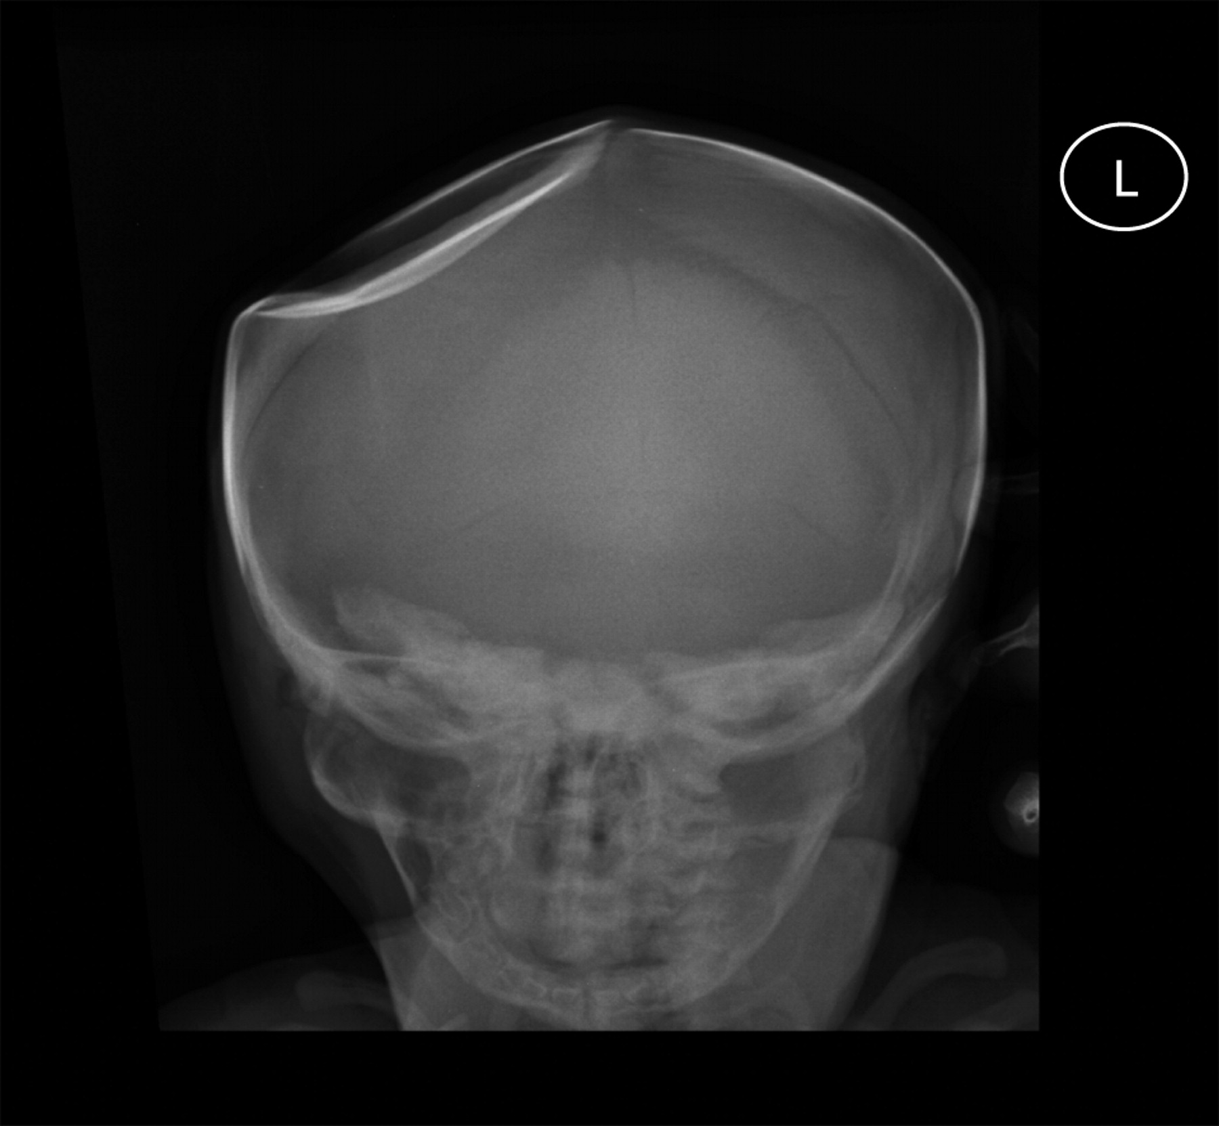

Slide 7
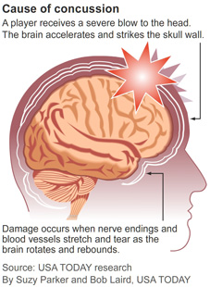
Brain Injuries - Concussions
Concussions are common in sports activities
Caused by the brain hitting the skull
Symptoms
Being unaware of surroundings, date, time, place
Loss of consciousness
Confusion
Amnesia
Headache
Dizziness
Nausea
Unsteadiness/loss of balance
Ringing in the ears
Double vision or seeing flashes of lights
Sleepiness
Sleep disturbance
Convulsions
Exhibiting inappropriate emotions
Vacant stare
Slurred speech

Slide 8
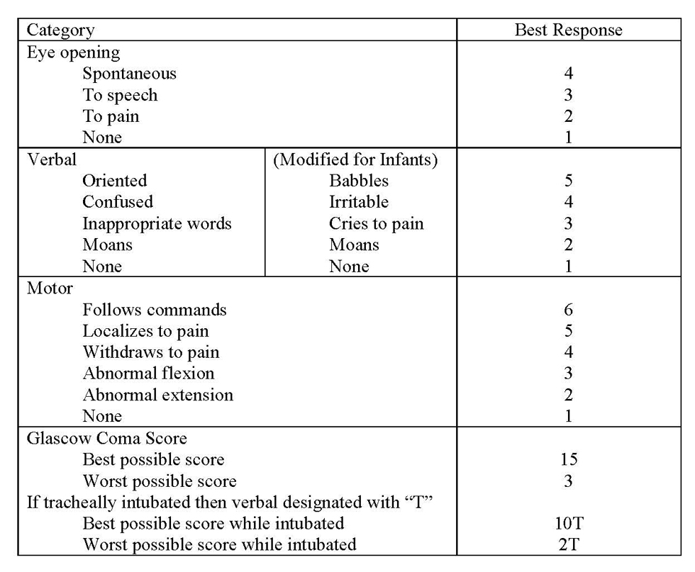
Concussions Grading Scale
Several different scales exist for grading concussons
Glasgow Coma Scale
The American College of Surgeons Committee on Trauma has adopted the AVPU method
Investigates where individual is alert, responsive to verbal stimuli, responsive to painful stimuli, or unresponsive

Slide 9
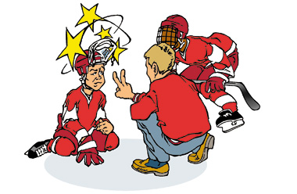
Treatment of Concussion
Includes reviewing history of the injury
Inspection
Palpation of cervical vertebrae and musculature
Neurological screening of sensory and motor function and pupil size
Raised intracranial pressure and temporal lobe herniation
Can cause compression of
oculomotor nerve resulting
in pupillary dilation

Slide 10
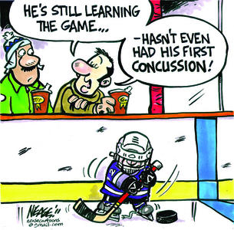
Treatment (con’t)
Immediate removal from game or practice
Close monitoring for deterioration
Medical evaluation
Medically supervised, stepwise process to determine RTP status

Slide 11
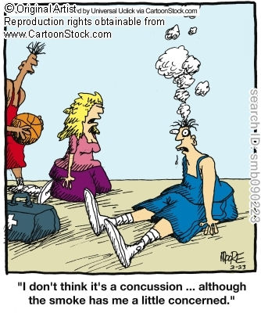
Amnesia
Retrograde amnesia
loss of memory for events that occurred before the injury
Antegrade amnesia
Loss of memory for events occurring immediately after awakening from a loss of consciousness
Postconcussion syndrome may develop following a concussion
Athlete should be monitored for symptoms periodically

Slide 12
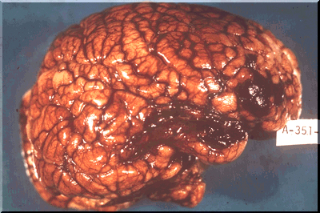
Brain contusions
Bruising of the brain
Can result in a lack of nerve function of the bruised portion
Usually will not cause a loss of consciousness
Symptoms
Numbness
Weakness
Loss of memory
Aphasia
Loss of speech or
comprehension
General misbehavior

Slide 13
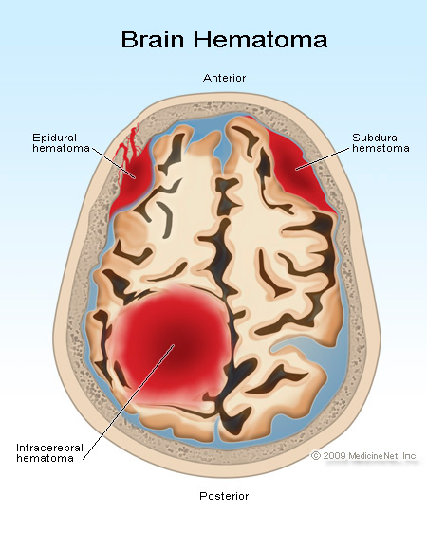
Hemorrhage
Bleeding in the brain is life-threatening
Subdural hematoma
Develops when bridging cerebral vessels that travel from the brain to the dura mater are torn.
The most frequent cause of death from trauma in athletics
Epidural hematoma
Develops when a dural artery is ruptures
Often associated with a skull fracture
Intracranial hematoma
Develops when a blood vessel within the brain are damaged
All hematomas can cause an increase in intracranial pressure that can lead to death or disability if not dealt with appropriately

Slide 14
Second Impact Syndrome (SIS)
Involved rapid swelling and herniation of the brain after second head injury occurs before the symptoms of a previous injury have been resolved
The second injury may not even be a blow directly to the head, but to a nearby area that causes the head to react to the blow
Ex. Chest, back
Prevention is the only sure cure. Athletes must not be allowed to participate in contact or collision activities until all cerebral symptoms have subsided

