Slide 1
Head/Neck/Spinal Injuries
Recognition, Response & Management

Slide 2
Recognition
http://www.youtube.com/watch?v=3-TI7nsxcOw
When an athlete has a suspected head/neck or spinal injury, the response is the same for all emergencies.
The athlete may have been the victim of a violent hit and as a result fall limp to the ground or a mechanism called AXIAL LOADING.
An athlete who is showing no signs of movement after a hit should be suspected to have suffered a head/neck or spinal injury.

Slide 3
Concussion Management
If there is no neck injury suspected, continue assessment for a concussion.
Complete a history and continue through the physical and cognitive testing methods to assess the severity and inform parents of the treatment guidelines.

Slide 4
Response
When responding, stabilize the head & neck and begin an initial assessment of the athlete’s condition.
If they are conscious and are complaining of neck pain call for EMS and prepare to load him/her onto a spine board.
Instructions for response:
https://www.youtube.com/watch?v=tR4O9pvnFuw

Slide 5
Prepping for transport – recap from Video
Log roll the athlete if they are in a prone position. If a board is available, they can be placed directly on the board.
The athlete must be “rolled” into a supine (face up) position in order to access the airway.
The person at the head stays at the head until the athlete is secure.

Slide 6
Reasons to Move Injured Athletes
Life Threatening or serious illness
Danger of further harm
Environmental Emergencies
Unable to provide first aid for Life-Threatening Conditions
Unresponsive athlete lying on stomach
Heat stroke

Slide 7
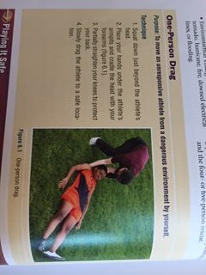
One-Person Drag
Purpose: to move an unresponsive athlete from a dangerous environment by yourself
Squat down just behind the athletes head
Place your hands under the athletes armpits
Cradle their head on your forearms
Bend your knees
Slowly drag the athlete away

Slide 8
Four or Five Person Rescue
Purpose: to turn over a responsive or non responsive athlete who is face down and MUST be moved or placed on a spine board.
Used to roll unresponsive athletes to a position where vomit could drain from the mouth

Slide 9
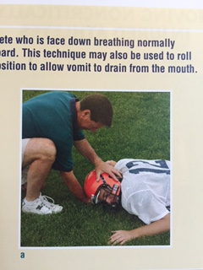
Four or Five Person Rescue
Stabilize the head

Slide 10
Four or Five Person Rescue

Slide 11
Four or Five Person Rescue

Slide 12
Moving Responsive Athletes
Minor or moderate injuries
Sprains and strains
Solar plexus
Facial Injuries
Fractures

Slide 13
One Person Walking Assist
Instruct the athlete to place an arm around your shoulder
Grasp the athlete around the waist
Instruct athlete to lean on you

Slide 14
Two Person Walking Assist
Two rescuers stand on either side of the athlete
Place the athletes arms around you and assistant’s shoulders
Hold athlete around the waist
Slowly walk to the sideline

Slide 15
Four Arm Carrying Assist
Purpose: to move a responsive athlete who is unable to walk
Stand behind the athlete
Grasp your right forearm with your left hand
Then grasp each others left forearm with your right hand

Slide 16
Two Handed
Grasp each others forearms
Instruct athlete to sit on the seat created with your forearms

